Slide 1

Design Project-II
Mechanical System Design
ME-418
Prepared by: Alex Puckett
Yaman Pandey

Slide 2
Project Summary
Design a feed/position an envelope.
Envelope size to be 4.125”x9.5”
Stamping motion that operates on a same mechanism.

Slide 3
Project Requirements
Must include a crank in the mechanism.
Must be one degree of freedom mechanism.
Required motions to be completed within one or two revolutions of the crank.

Slide 4
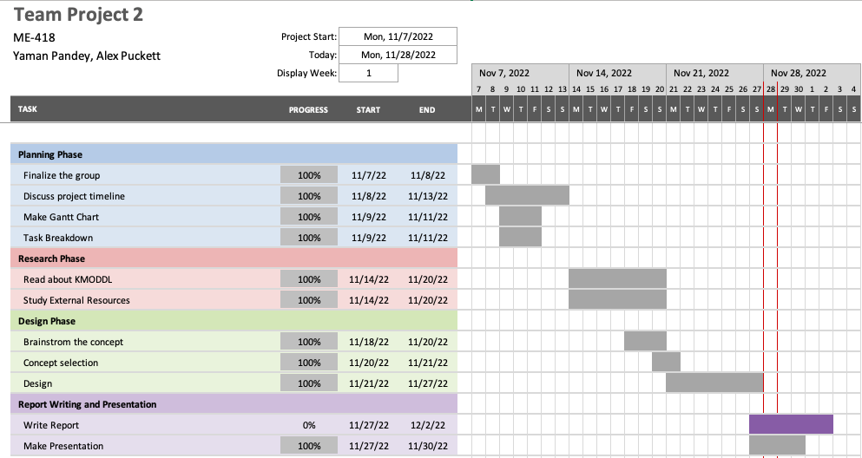
Project Timeline

Slide 5
Design Considerations

Slide 6
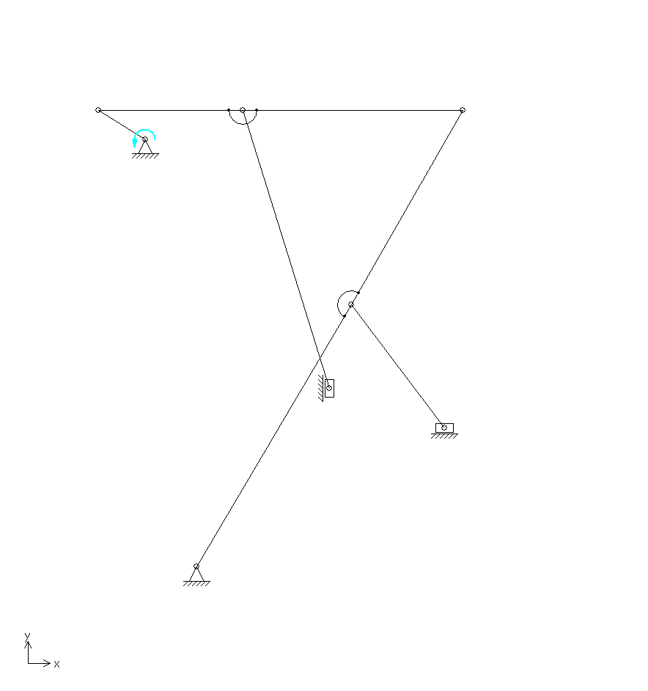
Design-1

Slide 7
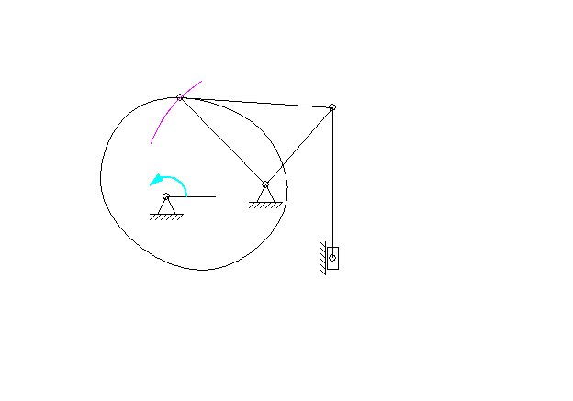
Design-2

Slide 8
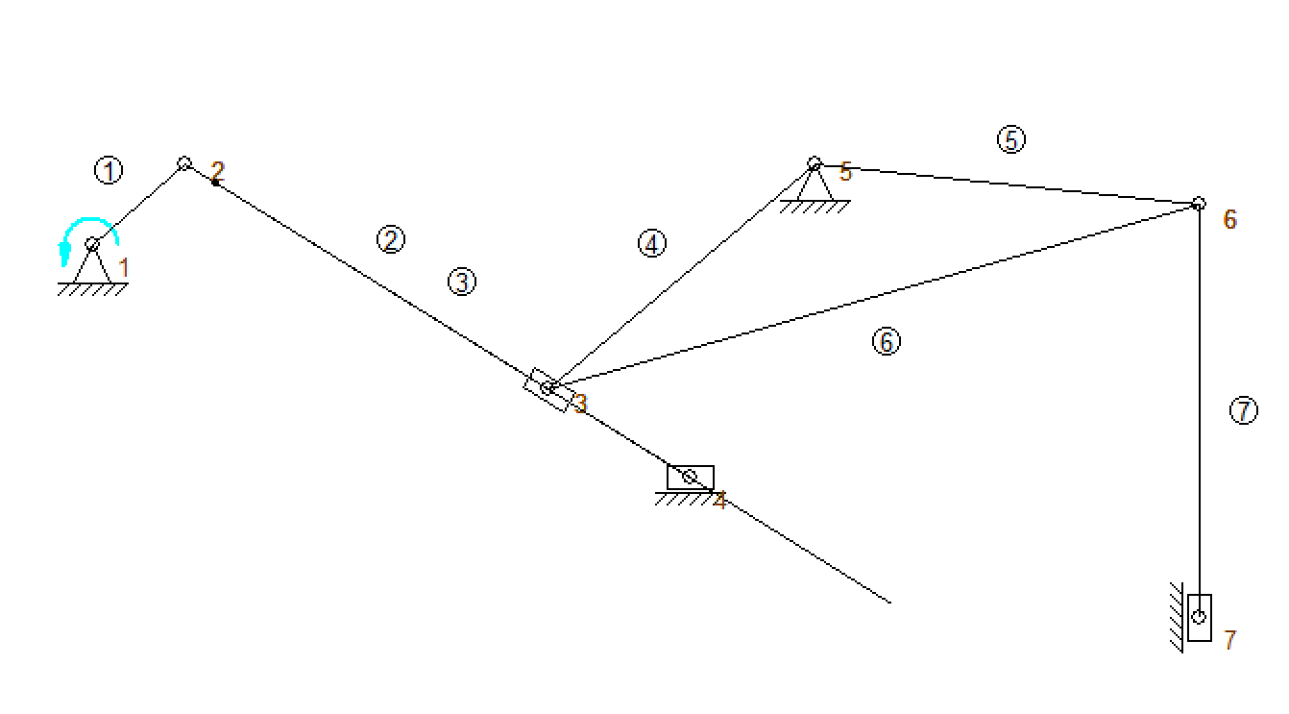
Design-3

Slide 9
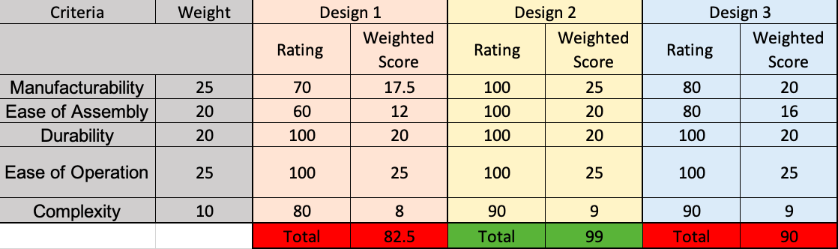
Decision Matrix
Best

Slide 10
Best Design

Slide 11

Thank You
Questions??

